Slide 1
Bootstrap Integration with Angular

Slide 2

Module Overview
Getting Started with ng-bootstrap
Start Coding With ng-bootstrap
Dropdown
Accordion
Popover
Tab
Demo Page

Slide 3



Getting Started with ng-bootstrap

Slide 4

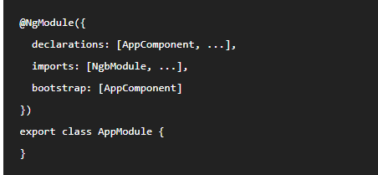
Getting Started with ng-bootstrap
list the imported module to your application module as follows:

Slide 5
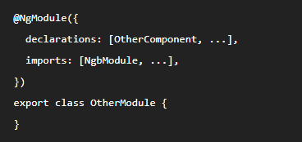
Getting Started with ng-bootstrap
Other modules in the application can simply import ngbModule as follows:

Slide 6
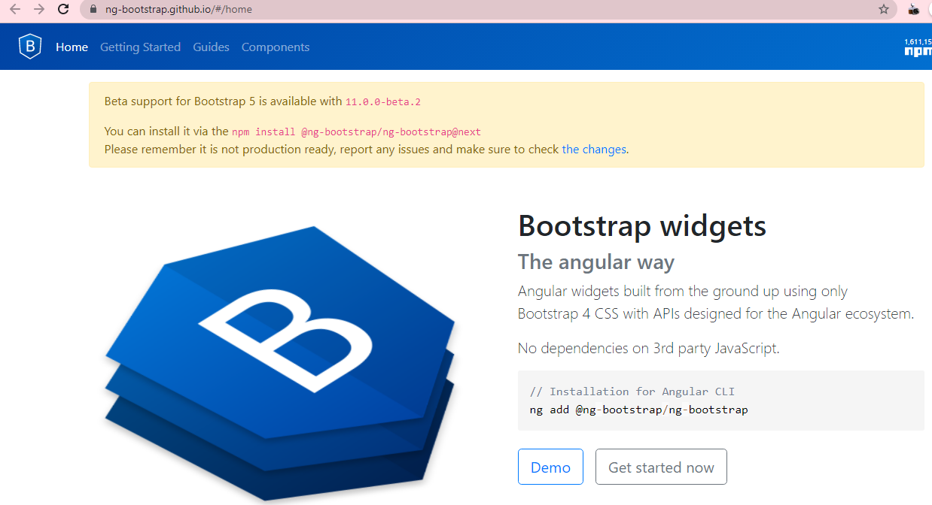
Start Coding with ng-bootstrap
https://ng-bootstrap.github.io/#/home

Slide 7
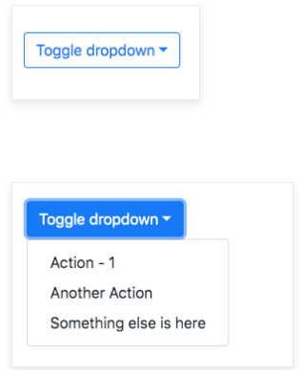
Dropdown

Slide 8
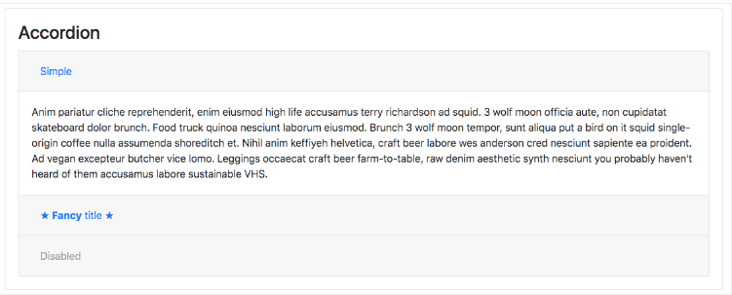
Acccordion

Slide 9
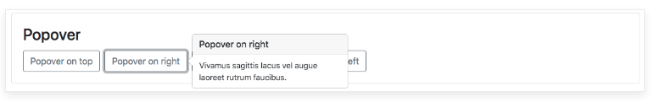
Popover

Slide 10
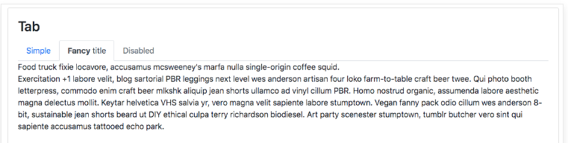
Tab

Slide 11
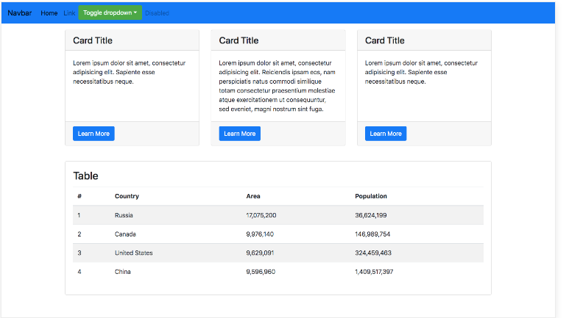
Demo Page

Slide 12
Summary
Getting Started with ng-bootstrap
Start Coding With ng-bootstrap
Dropdown
Accordion
Popover
Tab
Demo Page

